Slide 1
SALes MANAGEMENT SYSTEM
ESFP-II

Slide 2
OUR AIM FOR THE PROJECT→
Sales and management software will provide services for a marketing company for a better marketing of their products. In present competitive marketing business it had became hard for companies to provide consistent marketing solutions.

Slide 3
THE FUNCTIONS IN THE WHOLE Project ARE→
1) Welcome Page
2) Select your choice
3) Enter password
4) Authorized personal

Slide 4
HEADER FILES USED IN THE PROJECT→
#include<iostream>
#include<stdio.h>
#include<stdlib.h>
#include<string.h>
#include<conio.h>
#include<windows.h>
#include<time.h>
#include<iomanip>
#include<ctype.h>

Slide 5
CONCEPTSof c++ language used
1. Class and Objectives.
2. Arrays.
3. Functions.
4. Structures.
5. File handling

Slide 6
BELOW IS THE EXECUTION OF THE PROGRAM AND FLOW OF THE PROGRAM →
1) This project is developed for computerizing of entire marketing statistics. This application is developed in different modules where each module is functioned at different levels to perform their work.
2)IT WILL ASK US ABOUT THE LOGIN ID AND LOGIN PASSWORD OF THE CONTROLLER OF THE PROGRAM TO ENSURE SAFETY OF THE DATA.
3) 4)FINALLY THE MAIN PAGE WILL SHOW UP WITH ALL THE OPERATION THAT COULD BE PERFORMED BY THE BUILT SOFTWARE.

Slide 7
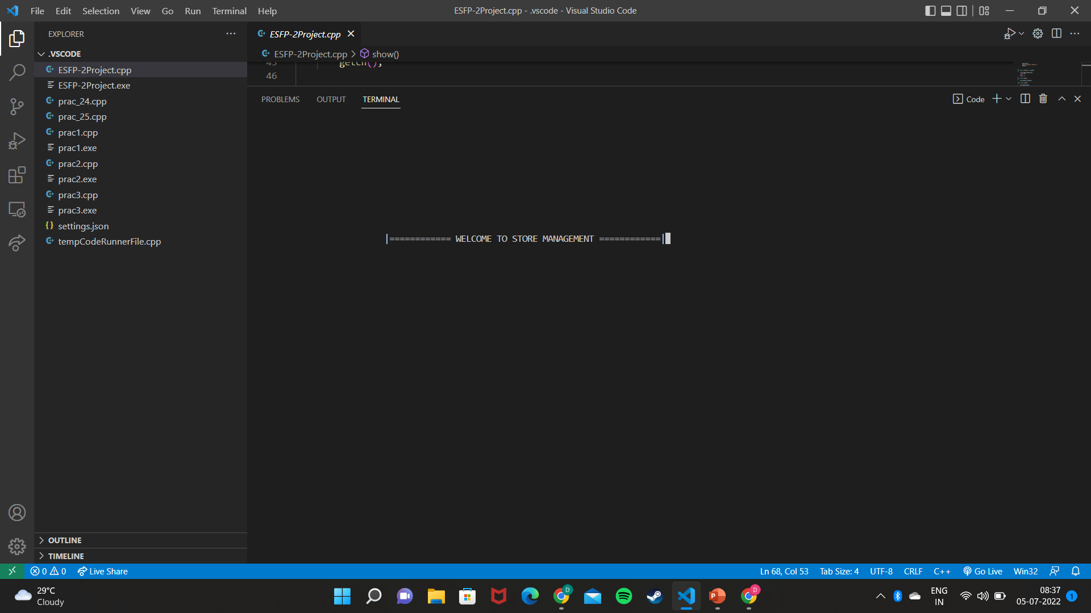

Slide 8
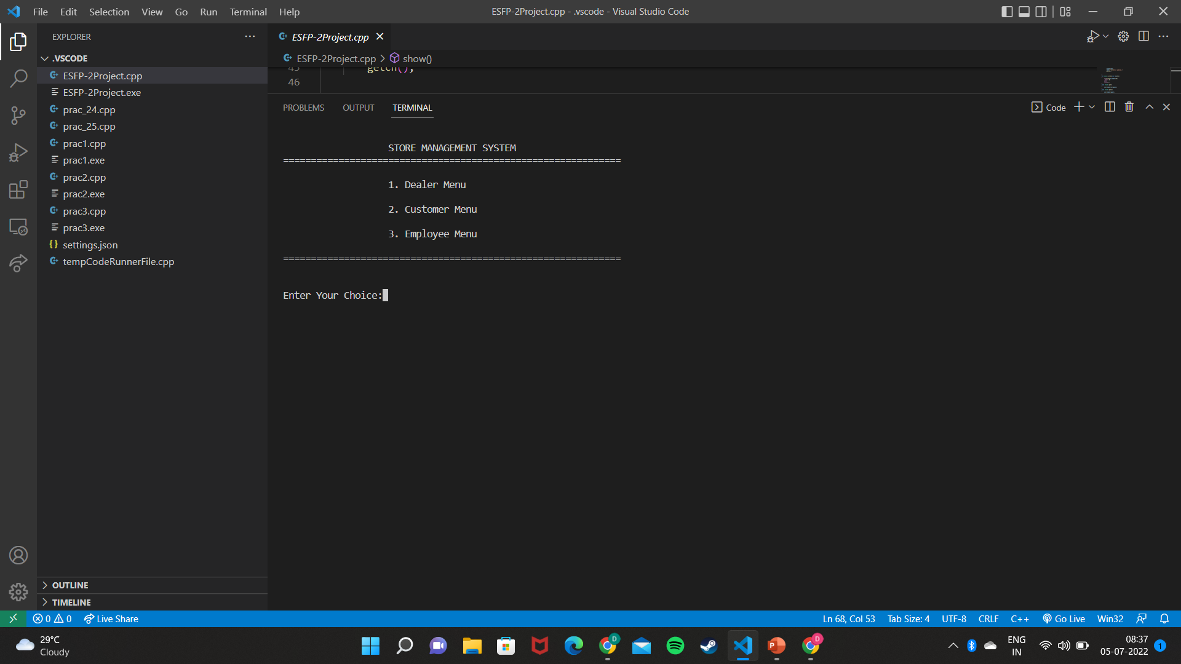

Slide 9
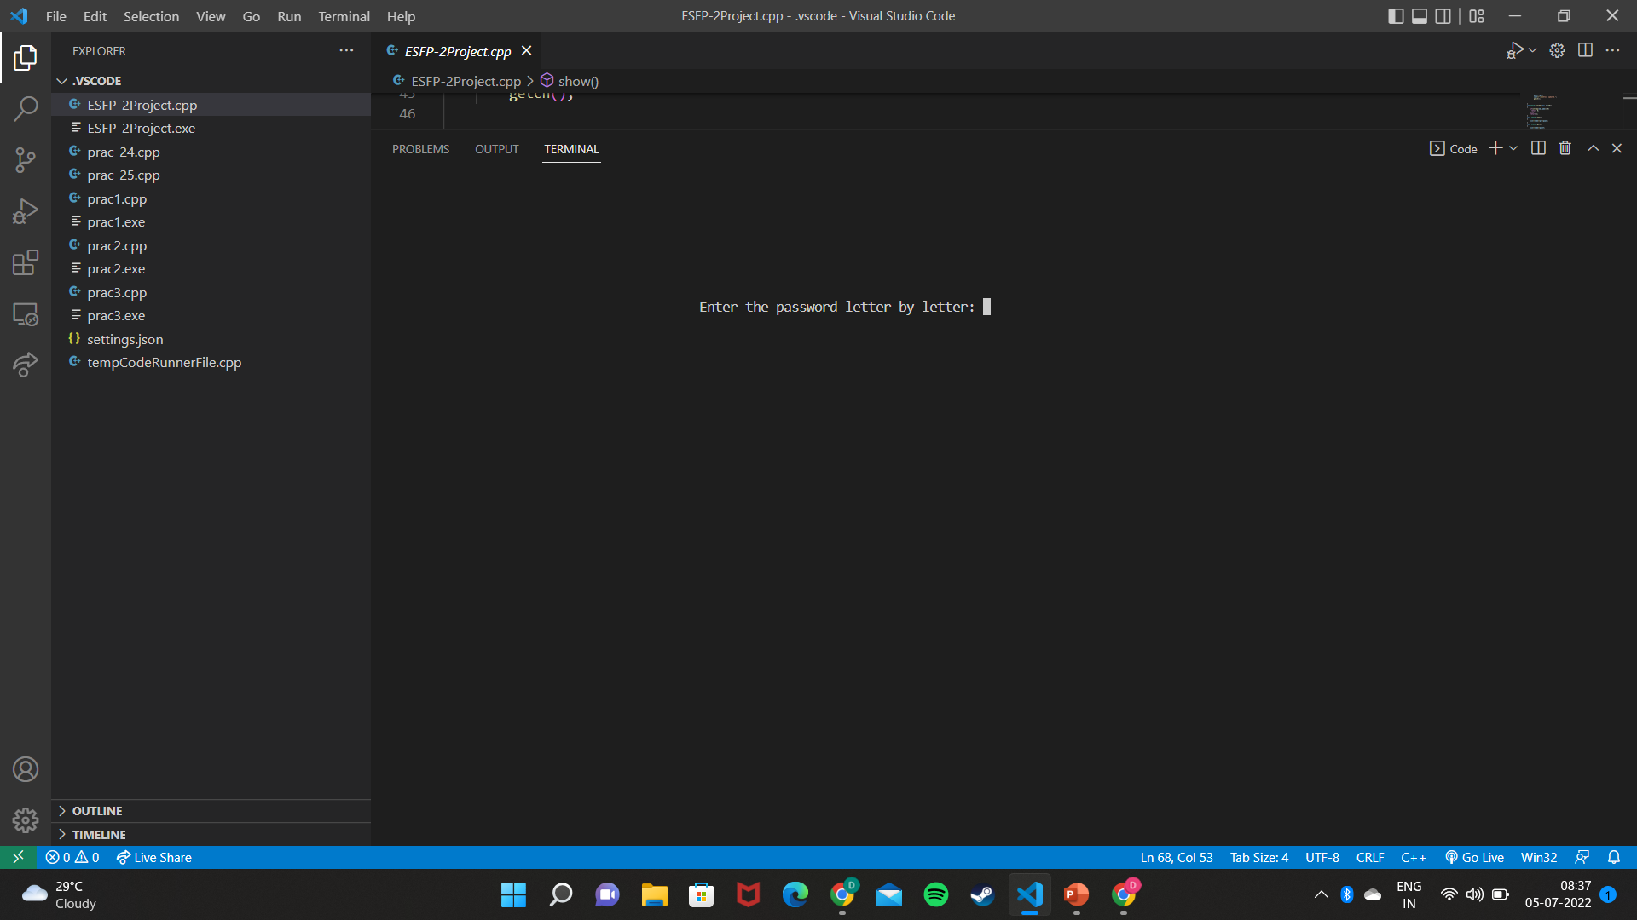

Slide 10
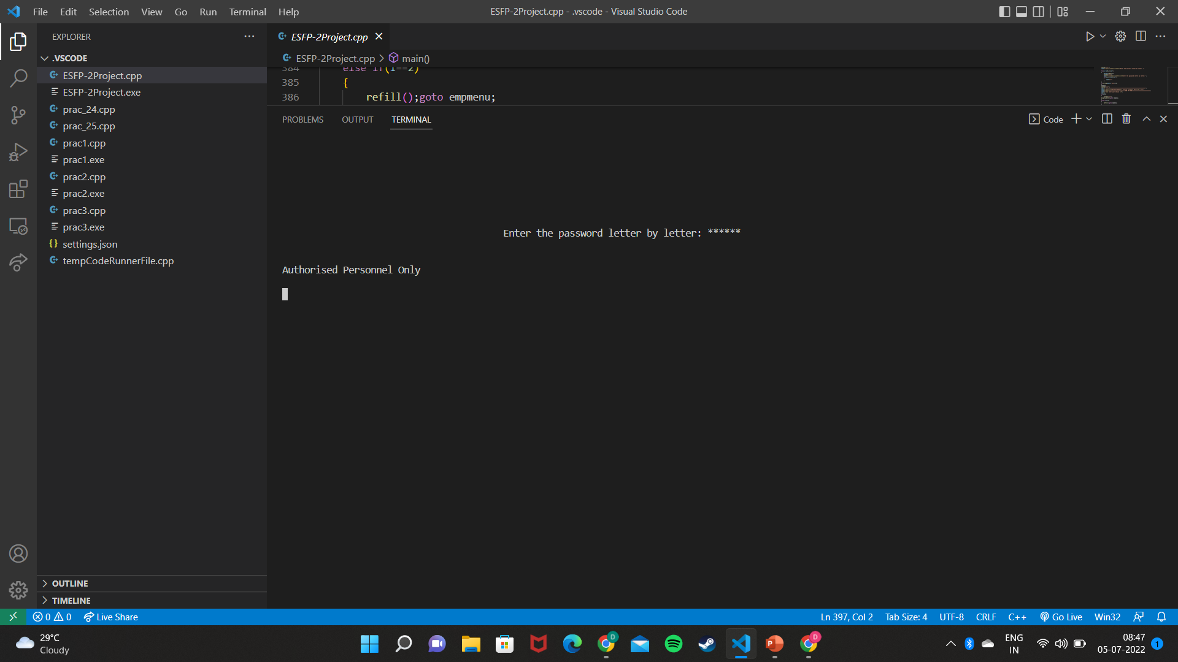

Slide 11
THANK YOU
-DEVarsh pandya
ENROLLMENT NO. → 21162101015

